Slide 1
Leveraging Community College and Business Partnerships to Expand Education, Training, and Employment Opportunities in Bioscience
Judith A. Alamprese
Principal Scientist
Abt Associates
TCI Symposium, Nov. 10, 2015
judy_alamprese@abtassoc.com

Slide 2
Today’s Presentation
Overview of Community College Consortium for Bioscience Credentials (c3bc) & Abt Associates’ evaluation
Focus of c3bc’s partnerships between community colleges and business/industry associations
Strategies used to form, implement, & sustain partnerships in c3bc, using framework from social exchange theory
Implications for outcomes studies, scaling of partnership approaches

Slide 3
Community College Consortium for Bioscience Credentials (c3bc)
TAACCCT, Round 2
Grantee: Forsyth Technical Community College and 11 partner colleges
Evaluator: Abt Associates
Funded by DOL #TC-23761-12-60-A-37

Slide 4
c3bc Core Activities
Bridge gap between TAA and other displaced workers and their preparation for bioscience workplace through:
expanded recruitment
redesigned courses
improved retention in bioscience programs
Harmonize set of core skills for biosciences that facilitates creation of pathways and provision of training leading to industry-recognized credentials

Slide 5
c3bc Core Activities
Enhance training programs and accelerate certificate and credentialing processes in biosciences through:
prior learning assessment
focused support services
technology-enhanced instruction
Build community college capacity for education and training that meets employer needs through partnerships
designing and delivering instruction
placing students into employment
providing internships and other activities that prepare students for the workplace

Slide 6
c3bc Hub Structure
Biomanufacturing Hub: Revalidate biomanufacturing skill standards
Montgomery County Community College (PA): Lead
Bucks County Community College
Los Angeles Valley College
Medical Devices Hub: Develop new skill standards
Ivy Tech Community College: Lead
Salt Lake Community College
St. Petersburg College

Slide 7
c3bc Hub Structure
Lab Skills Hub: Revalidate lab skills standards
City College of San Francisco: Lead
Madison Area Technical College
Austin Community College
Learning Technologies Hub: Contextualized & modularized learning
Forsyth Technical Community College
Alamance Community College
Rowan-Cabarrus Community College

Slide 8
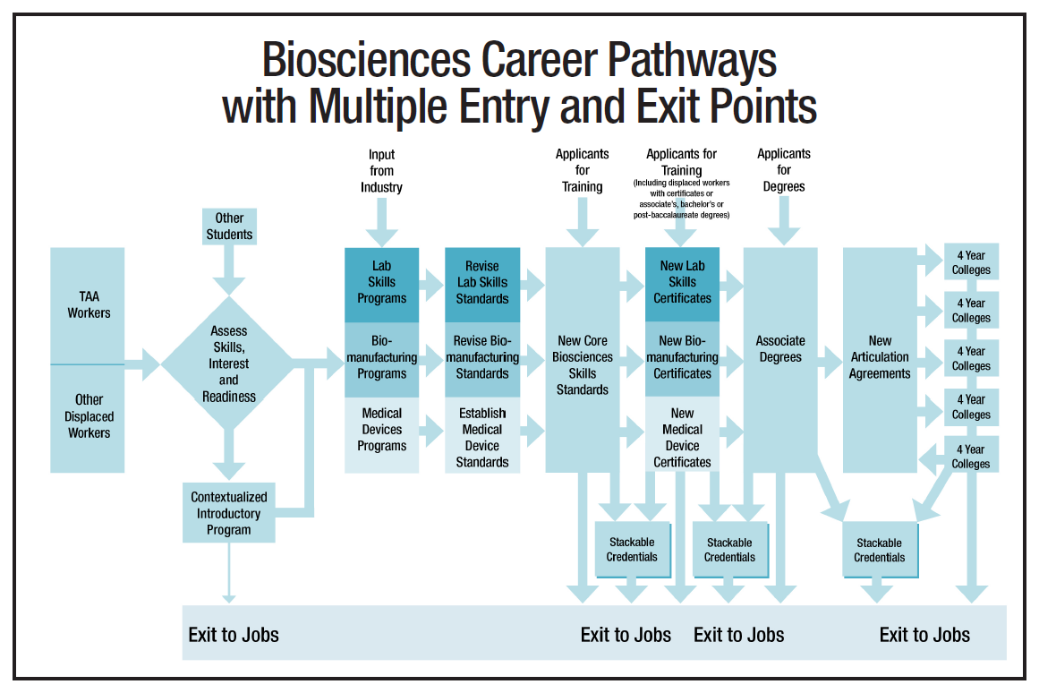
c3bc Project Model

Slide 9
Abt Associates’ Evaluation
Implementation Study: Determine…
Processes c3bc colleges used to develop and carry out four core activities of project
Operational strengths and weaknesses of project after c3bc colleges’ implementation of core activities
Implementation Study Data Collection
Two round of site visits: in-depth interviews, class observations, materials review
Telephone interviews in between site visits
Monthly project conference calls
Quarterly progress reports on all project activities
Impact (QED) Study: Forsyth Tech’s redesigned biology and chemistry studies
Outcome Studies: eight colleges’ newly developed courses and credentials

Slide 10
c3bc Partnership Approach & Activities
Role of community college-business partnerships
One of four core project activities
Leverage prior collaborative Federal grant work among hub directors
Intent to strengthen relationship between colleges and industry nationwide with core skill standards
Involvement of national and state bioscience associations
Partnership development and expansion
Contacts through c3bc project director, department, college management of employer
Used local labor market analyses

Slide 11
c3bc Partnership Approach & Activities
Partnership development and expansion: Affected by…
Number and size of employers in region related to bioscience
State bioscience associations’ interest in project
Program design and delivery
Most colleges had existing courses that were used as base for reconfiguration and expansion for new purpose, new credentials
Involvement of business & industry varied with stage of course development, time availability, experience of c3bc staff in design
Two colleges involved in significant new design, conducted extensive outreach to involve employers in course & credential design and delivery, particularly for entry-level technician certificates

Slide 12
c3bc Partnership Approach & Activities
Student supports
Use of internships varied by experience of college, size of employers, hub focus
Employment –related activities
Guaranteed interview if complete courses/certificate
Career advancement if complete c3bc courses/certificate promoted by employer
Skills standards development/revalidation
Modified DACUM process
Feedback from industry associations
c3bc National Advisory Committee

Slide 13
Community College-Employer Partnership Logic Model
Influential Factors
Activities
Outputs
Outcomes
Prior/Existing Relationship between College & Employer
Program Management & Leadership
Employer
More training options, sources of employees
Employer
More qualified applicants
Offset in recruit., training costs
Better productivity
Program Design
Labor Market
Program Delivery & Support
College
Better aligned courses & credentials
New resources
Reputation of College in Providing Workforce Education & Training
College
-Increased students, credentials
-New work w/partner
Student Support
Participant
Job attainment, advancement
Wage increase
Employment Related
Size & Types of Employers

Slide 14
Strategies for Partnership Development, Sustainability, Growth
Understanding strategies extends knowledge, provides possible explanations, facilitates scaling
Framework for Strategies: Social Exchange Theory as applied in studies of partnerships to support adult basic skills career pathways
Theoretical perspective with roots in sociology, psychology
Social behavior viewed primarily in terms of pursuit of rewards and avoidance of punishment and other forms of cost individuals engage in to meet their needs
Micro and macro levels of theory

Slide 15
Strategies for Developing and Sustaining Partnerships
Identify potential partners
Information is gathered about labor market, possible employer background, prior relationship with college to assess potential for partnership
Opportunities to meet employer are identified— ”cold” calls, used state bio associations, other contacts as intermediaries

Slide 16
Strategies for Developing and Sustaining Partnerships
Form partnerships
Goals and objectives are set that are concrete and attainable—identified benefits to employer
A shared vision is developed with agreed-upon objectives and strategy—began with addressing one need
Data are examined to identify and/or support shared vision— college & employers discussed desired outcomes

Slide 17
Strategies for Developing and Sustaining Partnerships
Build process for monitoring and sustaining partnerships
Partnership involves multiple organizational levels—president, HR, technical staff
Clear roles and guidelines are developed—how colleges and employer would communicate
Feedback on progress and outcomes from partnership is provided—reviewed student success, whether to continue

Slide 18
Community College-Employer Partnership Logic Model
Influential Factors
Activities
Outputs
Outcomes
Prior/Existing Relationship between College & Employer
Program Management & Leadership
Employer
More training options, sources of employees
Employer
More qualified applicants
Offset in recruit., training costs
Better productivity
Program Design
Labor Market
Program Delivery & Support
College
Better aligned courses & credentials
New resources
Reputation of College in Providing Workforce Education & Training
College
-Increased students, credentials
-New work w/partner
Student Support
Participant
Job attainment, advancement
Wage increase
Employment Related
Size & Types of Employers

Slide 19
Discussion—Implications for Scaling, Evaluation Design
Can be used as framework for professional development
Provides testable steps in organizational and individual partnership development and implementation
Requires collection of detailed, longitudinal implementation data about how, under what circumstances partnership activities occur
Requires employers to collect outcome data

