Slide 1
Engagement and Commitment Phase
Notes:
Overview -
The first Phase of PTR is Engagement & Commitment. It engages P-20 education leaders and other key stakeholders in identifying the Career Cluster, Career Pathway, Programs of Study that should be the focus of the PTR project. During the Engagement & Commitment phase, a partnership should be formed. The partnership is a broad coalition of individuals who give guidance and support to the overall PTR project.

Slide 2
Purpose and Goals
Engage and gain the commitment of key partners and team members in implementing PTR and improving programs of study
Review existing data to help specify and refine the initial problem statement that is included in the PTR Charter.
Plan to transfer lessons learned to other programs and other problem areas that can benefit from the PTR process.
Notes:
The primary goals of the Engagement and Commitment phase are to:
Engage and gain the commitment of partners, stakeholders and individuals in implementing PTR.
Use information to specify the initial problem statement as part of the PTR Charter.
Plan to transfer lessons learned to other programs and other problem areas that can benefit from the PTR process.

Slide 3
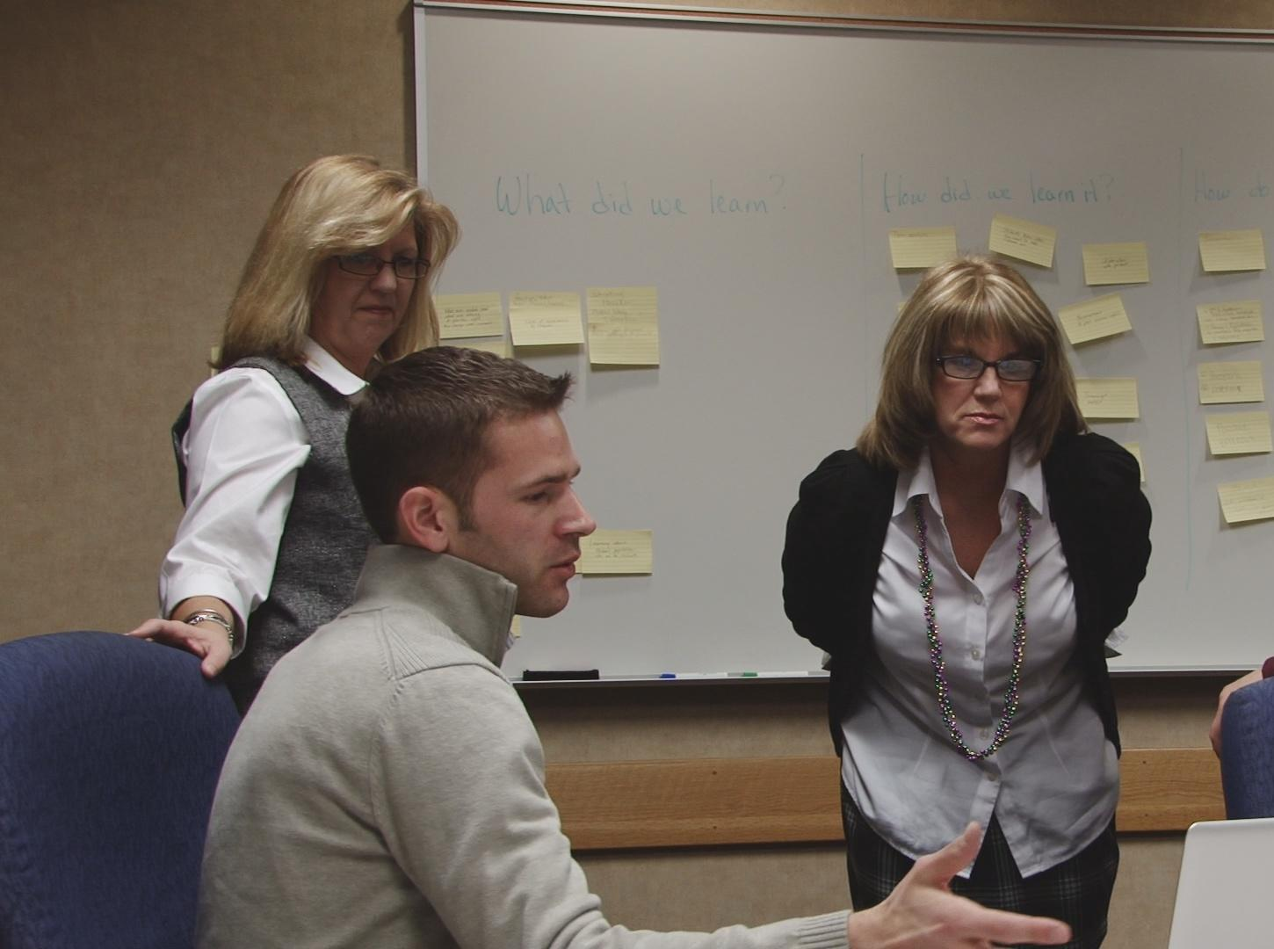
“Working together as a team is a valuable part of this process. The collaborative effort put forth by everyone was truly inspirational.”
- PTR Team Member, John A. Logan College Partnership
Notes:
“Working together as a team is a valuable part of this process. The collaborative effort put forth by everyone was truly inspirational.” Team Member, John A. Logan Partnership
Pathways to Results is about the power of “we” instead of the power of “me.”
The E & C Phase focus is centered around engaging different groups in a collaborative process. Not only was the collaboration valuable to this partnership, but they were able to gain both input and commitment from various groups to improve student outcomes. It is imperative that teams fully engage all stakeholders.

Slide 4
Outcomes and Equity
Stakeholders to engage actively:
K-12 schools
Colleges and universities
Business, industry and labor
Community leaders and groups
Parents and student groups
Notes:
The PTR process focuses on outcomes and equity of students. Phase One invites the Partnership and PTR team to engage in an open and thoughtful dialogue about the fundamental ways the identified program can be improved by closing gaps in academic achievement, high school graduation rates, college readiness, college completion, and other critical outcomes between different student groups.
Stakeholders are those in represent business, industry, labor organizations, K-12 schools, postsecondary education, and other community groups that represent the needs and interest of diverse populations need to be actively engaged. Especially important to include in this, and all phases of PTR, are individuals who work with underserved populations, including those who provide support services.

Slide 5

Importance of Partnerships

Slide 6
Steps of the
Engagement & Commitment Phase
Step 1: Form the Partnership
Step 2: Gather Input
Step 3: Identify and Convene the PTR Team
Notes:
There are three steps to the Engagement and Commitment phase.
The first step is to engage P-20 leaders and identify the Partnership. The Partnership will help to identify program areas that need to be improved. It is important to get the right people at the table to discuss areas of improvement.
In step two, the team will gather input from the Partnership. It will also review Perkins, WIA, and other funding sources; local and regional labor market data; and other relevant information. Finally, the team conducts a SWOT Analysis of the program in its current state.
The third step identifies and convenes the PTR Team. The Partnership group advises on individuals who should be selected as members of the PTR team.

Slide 7
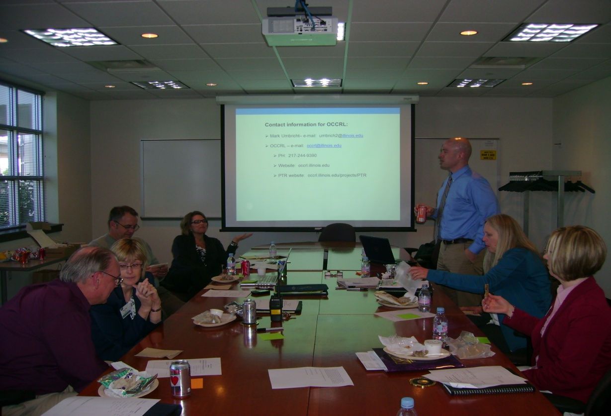
“We often think of resources around partnerships, but it is really more around ideas. The ideas that different folks bring to the table are really important.”
- Roger Sanders, Waubonsee Community College Partnership
Notes:
“We often think of resources around partnerships, but it is really more about ideas. The ideas that different folks bring to the table is really important.” Roger Sanders, Waubonsee Community College Partnership
Many previous partnerships found that engaging a diverse group of stakeholders was very beneficial to the PTR process. By inviting a wide variety of groups to the table, we can receive better feedback to align Programs of Study and improve student outcomes across the P-20 spectrum. With a collaborative effort, system change is possible.

Slide 8
Step 1
Engage P-20 leaders and identify partners by:
Obtain background information
Using the Programs of Study Expectations Tool
http://iccbdbsrv.iccb.org/programsofstudy/docs/IllinoisProgramsofStudyExpectationsTool.pdf
Hold first meeting
Notes:
Page 5 of the Module:
Step 1 – Engage P-20 leaders and identify the Partnership
First, background information must be obtained. Background information includes labor market information, grant applications, information on Career Clusters, Career Pathways, Programs of Study and Bridge programs, historical information on career and technical education, tech prep, and other educational reforms, pipeline performance measures and student outcomes, and related information.
Next, gather the results of the Programs of Study Expectations Tool. The Programs of Study Expectations Tool was developed by the ICCB. The purpose of this tool is to evaluate Programs of Study and determine promising practices and areas for improvement. Results of the Expectations Tool may reveal programs that have low enrollments, poor retention, or other problems and areas that would benefit from the PTR process.
Plan for and hold your first meeting to review the Programs of Study Expectations tool and select a Partnership.

Slide 9
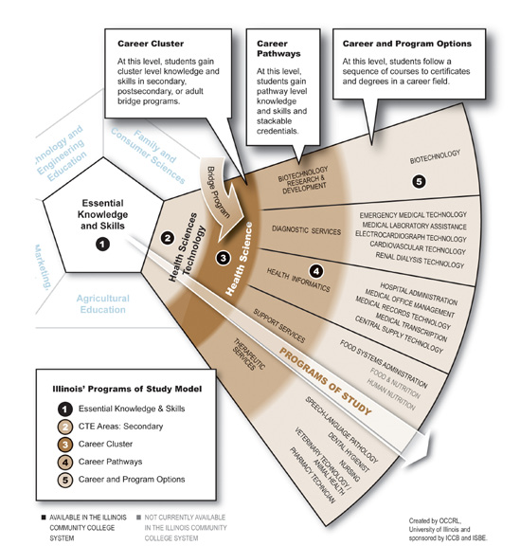
Program of Study “Fan”
Notes:
First, we need to explain the difference between a cluster, a pathway and career/program options.
Career Cluster is the broadest level. It can include health science, manufacturing, information technology, and other broad fields.
- At this level, students gain cluster level knowledge and skills in secondary, postsecondary, or adult bridge programs.
Career Pathways becomes more specific. This can include a narrow field such as health informatics or diagnostic services, as shown above.
At this level, students gain pathway level knowledge, skills and stackable credentials.
Career and Program Options are very specific. They include individual specific job titles, such as nurse or pharmacy technician.
- At this level, students follow a sequence of courses to certificates and degrees in a career field.

Slide 10
Step 2
Gather input from the Partnership
SWOT Analysis
Create first part of PTR charter
Notes:
Page 6 of the Module:
In step 2, information is gathered from the Partnership.
The Partnership must review funding sources; local and regional labor market data; and other relevant information. This collective period of study and reflection enables members of the partnership to create a shared understanding of the current status of P-20 education in the region and apply this knowledge toward the PTR process.
B. The Partnership conducts a SWOT Analysis, which stands for Strengths, Weaknesses, Opportunities, and Threats. What is a SWOT Analysis?

Slide 11
SWOT Analysis
Strengths | Weaknesses
Opportunities | Threats
Notes:
Page 11 in the Module - Appendix B
SWOT stands for Strengths, Weaknesses, Opportunities, and Threats.
The SWOT will be used to analyze the Program of Study that your team has chosen.
It will help to locate the strongest and weakest points of your program and will serve as a basis for your initial problem statement.

Slide 12
Step 3
Select the PTR team leader and members
Convene the PTR team and identify initial problem
Order from the Outcomes Menu
Draft the initial section of the Charter
Notes:
Page 6 & 7 of the Module:
The Partnership advises on individuals who should be selected as members of the PTR team, including selecting the leader of the PTR team.
This allows the Partnership to “own” the PTR process, even when individual members cannot be physically engaged in all PTR meetings.
B. The team leader has the primary responsibility for extending meeting invitations, gathering materials for the team meetings, and for
providing direction and support throughout the entire PTR process.
C. The PTR team must meet and review student outcomes and performance measures that already exist. (There is a tool we will use later today during the Activity, called the Outcomes Menu in Appendix E that will help the team with this process.)
D. The team will need to work collaboratively to update their PTR Charter and develop a plan for the remainder of the PTR project.

Slide 13
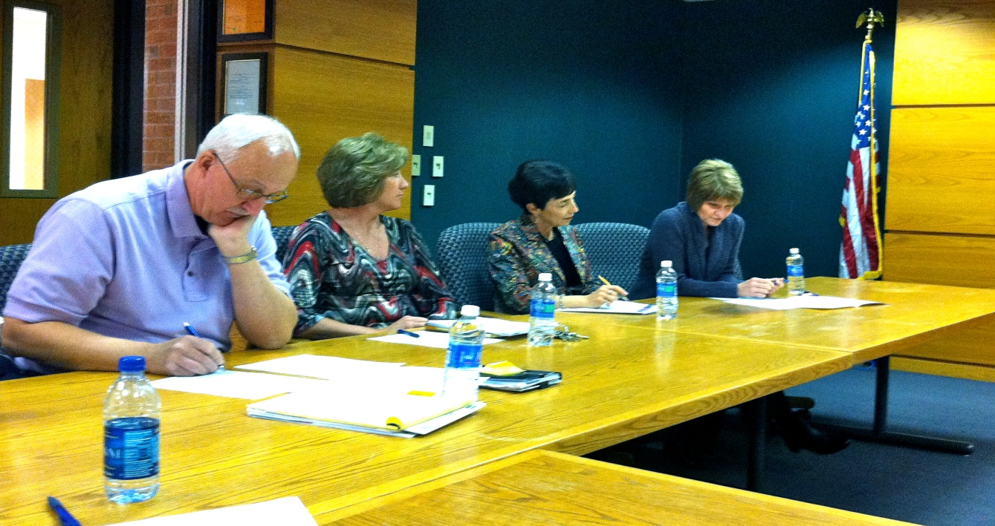
“As I reflect on the PTR process, something that stands out for me is the importance of laying a solid foundation for others outside the core team to commit to the established goals.”
- Sherry Hott, Southwestern Illinois College Partnership
Notes:
“As I reflect on the PTR process, something that stands out for me is t he importance of laying a solid foundation for others outside the core team to commit to the established goals.” Sherry Hott, Southwestern Illinois College Partnership
This first phase really does lay the foundation for the entire PTR process. By inviting the right people to the table, a team can ensure
that they have a quality leader and people with the skills that are needed to really make a difference for their students. If you set a solid foundation,
you will have the support of all of your partners including those that are not part of the core team. Just because someone cannot make every
meeting does not mean they should not be involved in the process.

Slide 14
Relationships Are Key

Slide 15
Engagement & Commitment Webpage
This link will take you to the PTR Webpage that provides tools and support materials needed to complete this phase.
http://occrl.illinois.edu/projects/pathways/phases/1

Slide 16
References and Resources
Illinois Community College Board. (2011). Illinois’ Program of Study. Retrieved from
http://www.ilprogramsofstudy.org/.
Illinois Community College Board. (2011) Illinois Program of Study Expectations Tool.
Retrieved from http://www.icsps.ilstu.edu/POS/docs/IL-POS-Expectation- Tool-web.pdf
Jankowski, N., Kirby, C., Bragg, D., Taylor, J., & Oertle, K. (2009, June). Illinois’ Career
Cluster Model. Champaign, IL: Office of Community College Research and
Leadership, University of Illinois.

Slide 17
OCCRL
OCCRL – e-mail: occrl@illinois.edu
  PH: 217-244-9390
  Website: occrl.illinois.edu
  PTR website: http://occrl.illinois.edu/projects/pathways

