Slide 1
Phase Three: Process Assessment

Slide 2
“During the writing of our Phase Three report I came to truly understand the beauty of letting the process guide us to where we need to go instead of us deciding where we need to go regardless of what the data showed.” - Lauri Wiechmann, West Central Illinois Partnership
Notes:
Letting the PTR process work for you is vital to Phase Three. A common thread of previous teams was they were anxious to try to improve their student outcomes, so they naturally wanted to rush through Phase Three.
Phase Three is designed to give teams time to analyze the underlying process that could be changed in order to improve student outcomes. There may be a problem at the surface of the program. However, as the team digs deeper, they realize there is a completely different underlying problem or roadblock for their students.

Slide 3
Purpose and Goals
Identify major processes supporting the Program of Study
Describe the steps of a major process
Identify contributing factors to process issues
Notes:
The goals of phase three are:
To identify the major processes supporting the Program of Study that may impact the student outcomes and problems identified in the previous phases.
To describe the steps for those major processes and identify aspects within the process steps that might contribute to the identified problems.
To identify the primary contributing factors that cause the process issues and/or limit improvement.

Slide 4
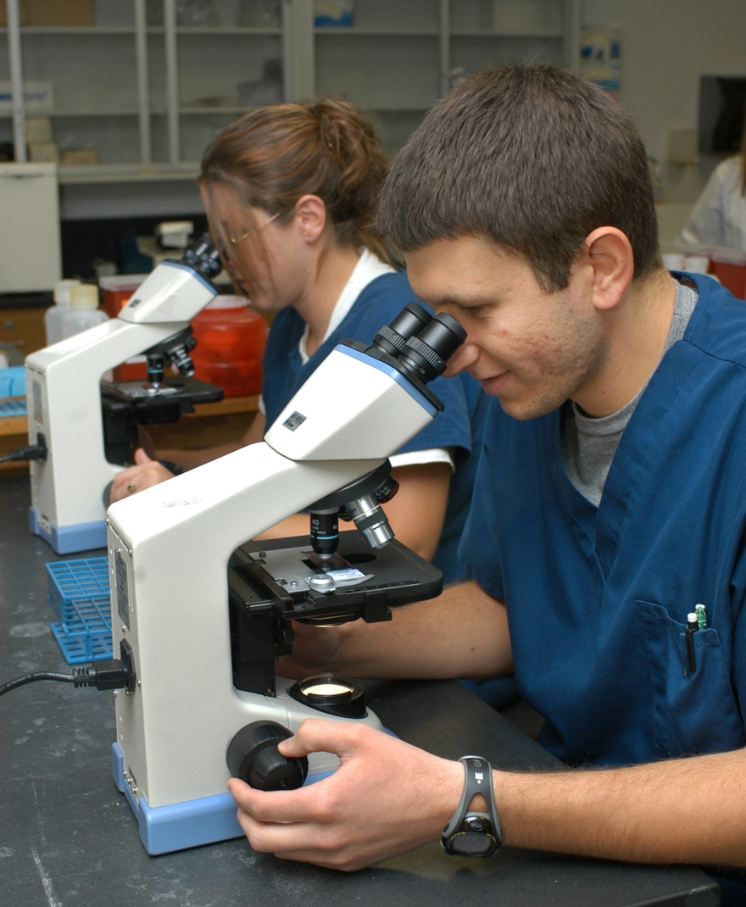
Outcomes and Equity
How does the process
contribute to student outcomes?
How might deficit thinking influence our perspectives?
How will improved processes help students achieve?
Notes:
In terms of outcomes and equity, this Phase is a means by which the “deficit thinking” that sometimes characterizes discussions of outcome inequities is overcome.
In other words, we move from the idea that “if we had better students we would have better outcomes,” to the idea that “if we create
better processes, our students will demonstrate better outcomes.”

Slide 5
Phase Three Steps
Step 1: Identify and Describe Major Processes
Step 2: Describe Detailed Steps
Step 3: Identify Contributing Factors
Notes:
There are three steps to Phase Three.
Step 1 is to identify and describe major processes that support student progress along the career pathway. The team will decide on one or more processes to analyze in depth.
In step 2 the team will Describe the detailed steps for the identified major processes. This step creates a thorough explanation of the processes the team has selected for review and creates a list of potential factors that contribute to their problems.
In step 3 the team will identify the potential factors that contribute to the identified problems. The purpose of Step 3 is to determine underlying reasons for the identified problems.
Understanding underlying contributing factors is essential if the team is to develop effective solutions. Teams want to treat the problem, not the symptoms.

Slide 6
Step 1
Identify and describe major processes that support student progress along the career pathway
PTR Process Inventory
Revisit problem description
Describe processes
Reach consensus on major process(es)
Notes:
Page 4 of Phase Three Module
First, the team identifies and inventories major processes associated with the identified problem, with a focus on the point of view of students
and their movement through the Program of Study.
The PTR Process Inventory (Appendix B) should be used to record the list and summarize the team’s notes.
B. Next, revisit the problem description developed during Phase Two and consider whether the problems are encompassed in the identified major processes.
C. Then, describe each major process by answering the questions listed on page 5 of the phase directions.
D. Finally, reach consensus on the major processes that should be examined in greater detail. Remember, processes should relate to the problems identified in Phases One and Two.

Slide 7
PTR Process Inventory
 | Major Process 1 | Major Process 2 | Major Process 3
Process Name: What do you call this process (e.g., assessment)? | Example: Advising
Purpose/Description: What is the purpose of the process? | To ensure students are registering for the courses pertaining to their Program of Study
Discussion: How does this process relate to the equity and outcomes identified in Phase Two? | Low income students are not enrolling until the semester begins and are unable to take classes in their Program of Study that have been filled
Decision: Does the team believe this process should be examined in greater detail? | Yes, identifying low income students and advising them on financial aid is important to their enrollment
Notes:
This is an example of a PTR Process Inventory page, where the team will create a list of major processes and then examine them in greater detail.
In the example shown above, the team chose the advising process to examine. They listed the purpose and description of the process, discussed whether or not this process can relate to the problems identified in Phase Two, and then decided whether or not to examine the process in greater detail.

Slide 8
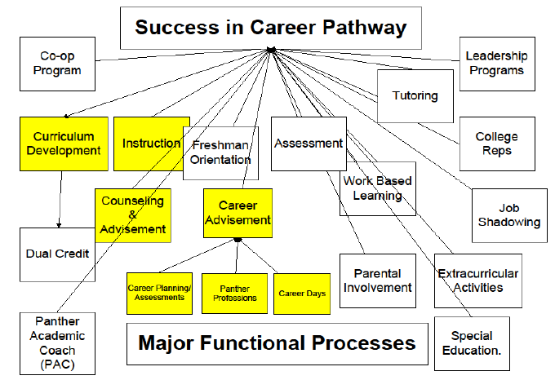
Major Process Inventory
Notes:
This is an example from practice of one team’s major processes in their students’ career pathways. They listed all of their major functional processes.
This particular team had many students who required remedial coursework once they entered the program.
So, which processes did they decide to study in further detail?

Slide 9
Major Process Inventory
Notes:
They chose to examine their curriculum development, instruction, counseling and advisement and career advisement.
The team decided that each of these areas could play a role in students being underprepared for the Program of Study.

Slide 10
Step 2
Describe detailed steps for the major processes
Identify and describe steps of process
Create graphic of process steps
Identify steps of process that contribute to problem statement
Notes:
Page 6
In step 2 the team will list the specific steps that currently exist for the major process, for each major process selected in Step 1. These steps do not need to be in any particular order, the team just needs to ensure all steps of the process are present.
Use the Detailed Process Description Worksheet (Appendix D) to describe each step. The description must focus on how the process currently functions, not on how the process is intended to function. The team will answer the questions: Who does this? What is done? What are the expected outcomes? As well as identify information about data, issues, and equity relating to the processes identified.
The team will then organize the steps in the order they are supposed to happen, ultimately creating a graphic representation. For example, let’s say the team chose advising as their process. The first step may be the students coming to see the advisor, then the advisor asking the student if they have chosen their major, and so on until the advising process has ended. A visual example will be shown on the next slide.
D. Finally, the team identifies elements of the process that contribute to the problems previously identified. Factors that influence equity and outcomes are identified and the team forms one or more hypotheses about why some elements of the process contribute to the selected problems.

Slide 11
Process Map
All students (entering direct from HS, GED or Returning Adults
Start
Recommend to meet with Academic Advisor to develop an educational plan
Is or becomes C.N.A. & begins gen. ed. courses
Accepted into Nursing Program
Attends Nursing Information Session
Success
Failure: Theory, Math
Take TEAS entrance exam and applies to the Nursing Program
Graduation
Enrichment Seminar and Remediation Tutoring
Graduation
Notes:
The graphic above is an example of a process map created by a previous PTR site. The team mapped their process for retention and success.
The process begins with students entering their program and follows them through all steps that are required to graduate, which is the end result of this process.
Having a visual representation can be beneficial because it may help to point out problem areas or potential roadblocks for students in their career pathway. Also, it will help to ensure that all team members are familiar with the process. Some previous PTR sites have mapped their process and come to realize they had never known just how many steps were in their own processes.

Slide 12
Complex Problems
Notes:
Since teams are addressing such complex problems, it is important during Phase Three to ensure you have the right people on board. For example, if a team is attempting to create a better alignment between their high schools and community colleges, it is important to have counselors from the high school and advisors from the community college present. Otherwise, you may be missing a piece of the process because you are not as familiar.

Slide 13
Step 3
Identify potential factors that contribute to the identified problems
Identify contributing factors and relationships between them.
Determine which factors are underlying contributors to the problem
Reach consensus on contributing factors
Notes:
Page 8 of Phase
In step 3, the team will first identify relationships among the contributing factors using a Fishbone Diagram, Relationship Diagram, 5W (Five Whys), Cause Map, or other tool. Examples can be found in the online resources section.
The result is a group of potential factors that appear to contribute to the problems. This activity is very important, because the identification of solutions needs to be based on a deep understanding of factors that impede student outcomes.
B. The team should record its answers to the following questions:
Does this factor contribute to the outcomes and equity issues identified in Phase Two?
Is this factor an underlying contributor to the process problem?
C. The team may need to conduct additional research to properly identify contributing factors, such as student focus groups or interviewing faculty or advisers.
D. The results of this research should be used to revise and expand on the team’s discussion. The team should reach consensus on the five questions listed on page 9 of the phase three module.

Slide 14
Fishbone Diagram
Notes:
The graphic shown is an example of a fishbone diagram used by a previous team. This team used the fishbone diagram to group contributing factors to student success.

Slide 15
“We were able to see what processes are currently in place and to see what barriers there are for students trying to enter into Waubonsee.” – Kristin Santillan, Waubonsee Partnership
Notes:
Phase Three is about identifying where students are hitting roadblocks in their path to a degree or certificate. This process will allow teams to find the steps of their processes that contain barriers for students. The next phase will involve removing those barriers to student success.

Slide 16
Phase Three in Action
Notes:
Since this site decided to examine recruiting, they felt it would be important to see how students viewed their process. Where did they find out about the program? Is there a better way to find out about the program? The team found that their students were filled with interesting and new ideas.

Slide 17
Phase Three Webpage
This link takes you to tools and support materials that your team needs to complete Phase Three.
http://occrl.illinois.edu/projects/pathways/phases/3

Slide 18
References and Resources
Dozois, E., Langlois, M. & Blanchet-Cohen, N. (2010). DE 201: A Practitioners Guide to
Developmental Evaluation. The J.W. McConnell Family Foundation and the
International Institute for Child Rights and Development. Available online:
http://www.mcconnellfoundation.ca/assets/Media%20Library/Publications/DE%2020
1%20EN.pdf
Process Description Worksheet is adapted from a similar worksheet produced by the National
Nuclear Security Administration, Equal Employment Opportunity and Diversity Office.
NNSA EEO Counselor Pre-Complaint Processing, Karen R. Harger, Patty Padilla,
8/24/2006. Available online: http://www.doeal.gove/eeo/docs/BusinessProcess.pdf
Tague, N.R. (2004). The Quality Toolbox: 2nd Edition. Milwaukee, WI: ASQ Quality Press. More
information about the book available online: http://asq.org/quality-press/display-
item/index.html?item=H1224
The instructions for step 3, including the Contributing Factors Worksheet are adapted from:
Improving Performance: A Five-Step Process, U.S. Department of Education, Division of
Vocational and Technical Education, Version 2, August 2002. pp. 14-19. Available
online: http://www.stemequitypipeline.org/_documents/Guidebook[1].pdf

Slide 19
OCCRL
OCCRL – e-mail: occrl@illinois.edu
PH: 217-244-9390
Website: occrl.illinois.edu
PTR website: http://occrl.illinois.edu/projects/pathways

