Slide 1
Phase Five: Review and Reflection

Slide 2
“During the PTR process, I had some “huh?” moments before “aha!” moments. However, now having gone through the process, I think that it can be effectively applied to other areas with valuable results.” - Cathy Flood, Parkland College Partnership
Notes:
Phase Five gives team members time to think about what they have learned from the Pathways to Results process.
In addition, it focuses on how a team’s solutions can be used to fix problems in other Programs of Study.

Slide 3
Purpose and Goals
To review and reflect on results of PTR
Document what individuals and team learned in the PTR process.
To identify ways PTR can be extended to other Programs of Study
To develop plans to sustain PTR solution
Notes:
The goals of this phase are:
To review and reflect on the results of the first four phases of PTR
To identify ways the PTR process can be extended to other Programs of Study.
To develop plans that insure that improvements to Programs of Study are sustained.

Slide 4
Outcomes and Equity
How will our solution help to produce equitable outcomes?
How will our solution be sustained?
How will our solution be transferred to other Programs of Study?
Notes:
This phase allows partnerships to reflect on whether or not the proposed solutions will help produce equitable outcomes.
This phase provides the opportunity to discuss and plan how successful solutions can be sustained and expanded to other areas that encourage more equitable student outcomes.

Slide 5
Steps of Phase Five
Step 1: Individual Reflection and Questionnaire
Step 2: Group Reflection
Step 3: Create Shared Understanding
Notes:
There are two steps in Phase Five.
In the first step, individuals reflect on their experience during the PTR process by writing a brief reflection about a significant idea, experience, or other aspect of the process and by completing a questionnaire about sustaining solutions.
In the second step, individuals meet to reflect as a group on what they have learned as part of the PTR process. The group will then consider all of the individual reflections and create a group reflection. This is followed by a discussion of the questionnaire results use in sustaining and extending solutions to other programs of study.

Slide 6
Step 1
Complete the individual reflection and questionnaire
Prepare personal reflection
Complete questionnaire about sustaining PTR solution and extending to other POS
Notes:
Page 4 of Phase Five Module:
In step 1, team members will complete the individual reflection and questionnaire.
First, individuals prepare a personal reflection of their experience during PTR using the Individual Reflection Tool (Appendix C). Each individual invited to participate in Phase Five, including the team leader, must prepare a statement that reflects a defining moment or breakthrough that the individual experienced or witnessed; what we call an “aha” moment.
Then, each individual must complete a questionnaire about sustaining their PTR solutions and extending them to other Programs of Study. The questionnaire will be distributed to each participant at the beginning of Phase Five.
Invitations to participate in this phase should be extended to anyone who has been involved in the entire PTR process. The more perspectives included in the reflective process, the more valuable the learning for everyone.

Slide 7
Example from questionnaire results
Notes:
The chart above is an example of a previous team’s questionnaire results.
The question asked if they felt their PTR solution would improve their Program of Study based on certain factors.
The scale is from -2 (strongly disagree) to 2 (strongly agree).
This team was very confident in their leader commitment and confident that their solution will improve student outcomes. Overall, this team was very confident that their PTR solution would improve their POS.

Slide 8
Step 2
Create a group reflection
Share individual stories
Individual reflection
Group reflection
Notes:
Page 4 of the Phase Five Module:
In step two, the team will create a group reflection.
First, each individual will share their story with the entire group and explain why they chose that story.
After each reflection, individuals should take a few minutes to consider what was read. Each person is asked to think about how each reflection addresses three questions:
1. What did we learn?
2. How did we learn it?
3. How do we feel about what we learned?
After all individual reflections are shared, phrases or words corresponding to each question are written on sticky notes or notecards and posted on flipcharts so that everyone can see them.
Then, group members develop a team reflection based on the responses to the three reflective questions. You will organize your sticky notes using an affinity diagram.
Once the affinity diagram is completed, the results of the questionnaire will be shared with the group. The group will discuss the results and summarize their thoughts using the following questions:
What do the questionnaire findings mean?
How do the results help us determine our next steps to sustain the PTR solution(s) and extend them to other Programs of Study?

Slide 9
Three Basic Questions
What did we learn?
How did we learn it?
How do we feel about what we learned?
Equity
Gaps between students
Data
PTR
Excited
Happy
Students have great ideas
Communication
Meetings
Process Map
Anxious
Excited
Outcomes Understood
We are going in the right direction
Retention Rates
By doing
Enlightened
Hopeful
Target the “right” students
Equity matters
Talk with student
Student Interviews
Nervous change may not happen
Looking to the future
Notes:
The graphic above represents an example of what a team may have on their flip charts before they create affinity diagrams.
The words and phrases represent what an individual felt or heard from others during their individual stories. There are no wrong answers and teams may add or take away thoughts as they see fit. The goal is to think of as many words or phrases as possible. Many thoughts will overlap during this process, but this is expected.

Slide 10
Three Basic Questions
What did we learn?
How did we learn it?
How do we feel about what we learned?
Equity
Outcomes Understood
Data
Excited
Excited
Equity matters
Retention Rates
PTR
Happy
Gaps between students
Process Map
Looking to the future
Meetings
By doing
Enlightened
Hopeful
Communication
We are going in the right direction
Students have great ideas
Talk with student
Anxious
Target the “right” students
Student Interviews
Nervous change may not happen
Notes:
The graphic above represents an example of what a team may have on their flip charts before they create affinity diagrams.
The words and phrases represent what an individual felt or heard from others during their individual stories. There are no wrong answers and teams may add or take away thoughts as they see fit. The goal is to think of as many words or phrases as possible. Many thoughts will overlap during this process, but this is expected.

Slide 11
Step 3
Develop a shared understanding
Reflect on the work accomplished
Create plan to sustain long term improvements
Integrate the reflection into on-going work
Notes:
Page 4 of the Phase Five Module:
In step two, the team will create a group reflection.
First, each individual will share their story with the entire group and explain why they chose that story.
After each reflection, individuals should take a few minutes to consider what was read. Each person is asked to think about how each reflection addresses three questions:
1. What did we learn?
2. How did we learn it?
3. How do we feel about what we learned?
After all individual reflections are shared, phrases or words corresponding to each question are written on sticky notes or notecards and posted on flipcharts so that everyone can see them.
Then, group members develop a team reflection based on the responses to the three reflective questions. You will organize your sticky notes using an affinity diagram.
Once the affinity diagram is completed, the results of the questionnaire will be shared with the group. The group will discuss the results and summarize their thoughts using the following questions:
What do the questionnaire findings mean?
How do the results help us determine our next steps to sustain the PTR solution(s) and extend them to other Programs of Study?

Slide 12
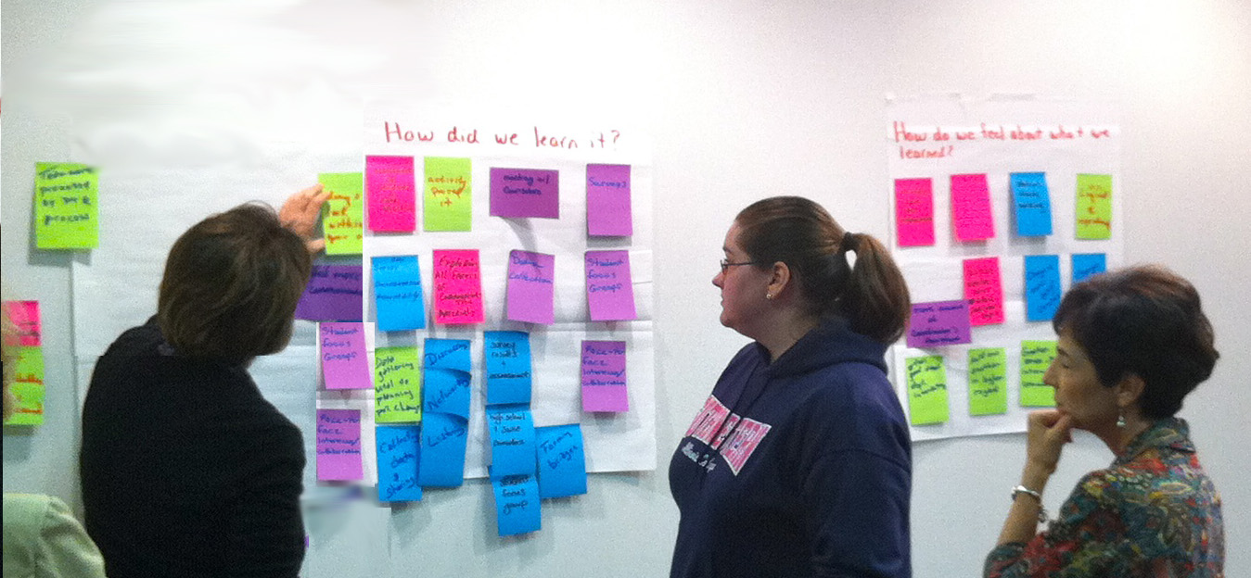
“It seemed that every meeting had a snowball effect. Review, revision, and
program improvement in one area had positive effects on another.”
- Sherry Hott, Southwestern Illinois College Partnership
Notes:
Many teams found it is easy to transition their PTR solutions into other Programs of Study.
Other teams found once they began implementation of their solution(s), other revisions needed to be made to improve student outcomes.
When we talk about Pathways to Results being about continuous improvement, this is what we mean. One change will lead to another, which can lead to another, and through this process students are the ones who gain.

Slide 13
Phase 5 In Practice

Slide 14
Phase Five Webpage
This link takes you to tools and support materials that your team needs to complete Phase Five.
http://occrl.illinois.edu/projects/pathways/phases/5

Slide 15
References and Resources
Denning, S. (2001). The springboard : How storytelling ignites action in knowledge-era organizations. Boston, MA: Butterworth-Heinemann. Information about the book available online: http://www.stevedenning.com/ Books/the- springboard.aspx
Feldman, S.P. (1990). Stories as cultural creativity: On the relation between symbolism and politics in organizational change. Human Relations, 43, 809- 828. Available online: http://hum.sagepub.com/content/43/9/809.full.pdf+html
Greenwood, J. (1998). The role of reflection in single and double loop learning. Journal of Advanced Nursing, 27, 1048-1053. Available online: http://www. communityhealthcarebolton.co.uk/SHA/LLL/resources/reflective/Greenwood. Pdf
McDrury, J., Alterio, M. (2003) Learning through storytelling in higher education. London: Kogan Page. A review of the book is available online: http://escalate.ac.uk/1520
Patton, M. Q. (2011). Developmental Evaluation: Applying Complexity Concepts to Enhance Innovation and Use. New York, NY: The Guilford Press.

Slide 16
OCCRL
OCCRL – e-mail: occrl@illinois.edu
PH: 217-244-9390
Website: occrl.illinois.edu
PTR website: http://occrl.illinois.edu/projects/pathways

