Slide 1
Finding the Evidence that Works for Reality: Navigating the Expectations from the U.S. Department of Labor
Soko S. Starobin, Ph.D.
Associate Professor and Director, Office of Community College Research and Policy
Iowa State University
TCI Symposium
November 10, 2015

Slide 2
Presentation Outline
Introduction
Cultural changes in CTE program evaluations
Conversation among evaluators regarding outcome and impact evaluation studies
Guiding Framework
The Flutter Effect Framework (Starobin, Hagedorn & Darrow, 2014)
Notion of “scale-up” in the context of higher education (Kezar, 2011)
Outcome Measures in CTE
Performance Indicators – Carl Perkins Grant (DOE)
Outcome and Impact Studies – TAACCCT (DOL)
Implications

Slide 3
Cultural Changes in Evaluation
What have we looked at?
How have we looked at the program outcomes and performance?
Why have we looked at those measures?
Where (at what level) have we looked at those measures?

Slide 4
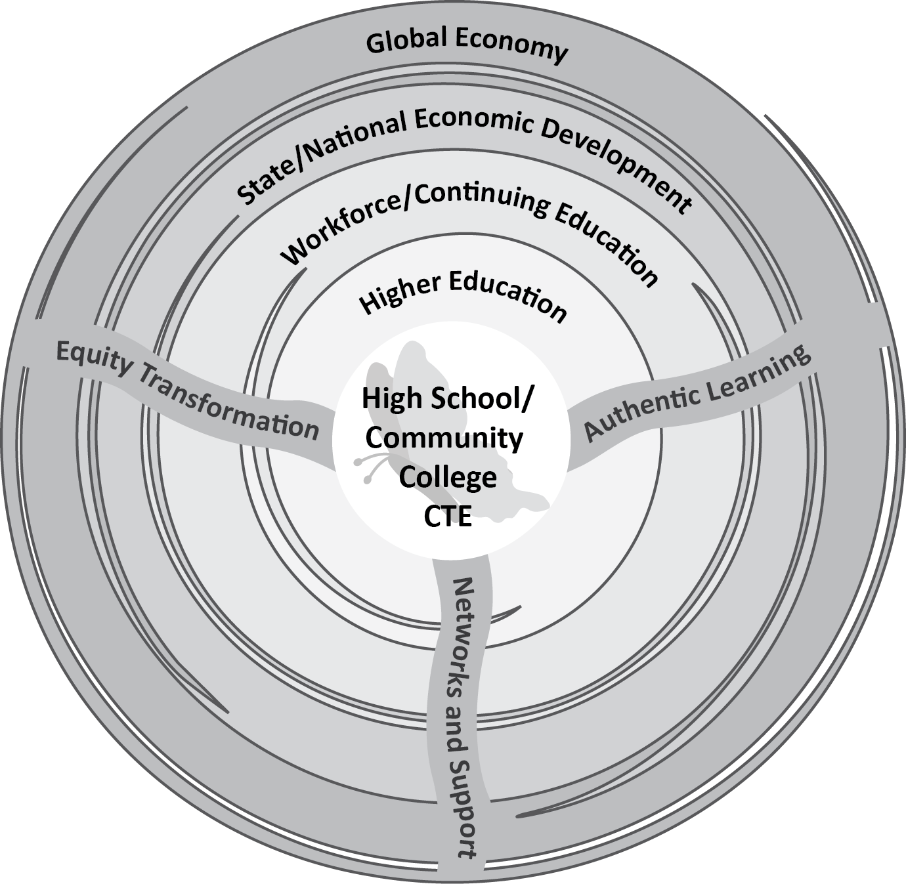
Guiding Framework
The Flutter Effect Framework (Starobin, Hagedorn & Darrow, 2014)

Slide 5
Guiding Framework
Notion of “scale-up” in the context of higher education (Kezar, 2011)
Higher education leaders should follow a broader adoption of innovation (mutual adaptation and social movements) rather than one being suggested by many policy makers, government agencies, and foundations through a scale-up model.

Slide 6
Outcome Measures in CTE
Performance Indicators – Carl Perkins Grant (DOE)
Alignment
Collaboration
Accountability
Innovation

Slide 7
Outcome Measures in CTE
Outcome and Impact Studies – TAACCCT (DOL)
Increase attainment of degrees, certifications, certificates, diplomas, and other industry-recognized credentials
Introduce or replicate innovative and effective methods for designing and delivering instruction…for TAA-eligible workers and other adults
Demonstrate improved employment outcomes

Slide 8
Implications
Moving away from mono-disciplinary lens
Advancing professional discourses and networks
Revisiting and re-conceptualizing the notion of “scale-up”
“While the scale-up language and approach to change is likely to be promoted by policymakers, it is in the best interests of educational leaders to sidestep this trap and promote other approaches to bringing innovations to scale.”
(Kezar, p. 241, 2011)

