Slide 1
Overview of the TAACCCT Grant Program and the National Evaluation

Slide 2
Topics
The National TAACCCT Evaluation
Objectives, research questions, data sources, and products
Initial Picture of the Rounds 1-3 TAACCCT Grant Program
Types of grants and grant awards
Institutions receiving TAACCCT funding
Planned program components, industries of focus, credentials, and partnerships
Third-party evaluations
Next Steps

Slide 3
Overview of the National TAACCCT Evaluation

Slide 4
Key Objectives of the National TAACCCT Evaluation
To provide a nationwide assessment of the overall initiative of the TAACCCT grants program through a formal implementation analysis and outcome analysis
To synthesize third-party evaluation findings, including lessons learned and promising practices and a systematic review of impact findings
To support third-party evaluators with conducting rigorous, independent evaluations, that include strong implementation and impact/outcomes analyses

Slide 5
Research Questions
What service delivery and/or system reform innovations resulted in improved impacts for participants?
Under what conditions can these innovations most effectively be replicated?
What are the types of emerging ideas for service delivery change and/or system reform that seem most promising for future research?
What directions for future research on the country’s public workforce system and workforce development in general were learned?

Slide 6
TAACCCT Conceptual Framework
Workforce Needs
TAACCCT Activities
Capacity-Building Outputs
Long-Term Outcomes
TAA-eligible and other workers - Need training for new or upgraded skills
Education and Training Program Development
TAACCCT Core Elements
Evidence-based design
Stacked and latticed credentials
Online and technology-enabled learning
Transferability and articulation
Strategic alignment
Student/Participant Education Outcomes
Enrollment
Persistence
Completion
Credentials
Establishing Innovative Education and Training Strategies
Expand student services
Train and hire staff
Upgrade supplies/equipment
Build/improve technology infrastructure
Add new facilities/renovate existing facilities
Develop articulation agreements
Build/improve evaluation capacity
Develop partnerships with employers, other institutions, and the community
Improved student/participant employment and earnings outcomes
Skilled workforce to meet employer demand
Well-connected, efficient systems in community/region
Increased employer involvement
Effective training programs at community colleges with capacity to serve students
Systems - Need to be better connected and more integrated
Community Colleges - Need to improve capacity to train students for high-demand occupations
Employers – Need for skilled workers
Transformation of training for adult workers
Contextual Factors: Economic Conditions and Policy/Budget Climate

Slide 7
Data Sources for National Evaluation
Administer a survey of all colleges (All Rounds)
Conduct site visits to selected grantees (Rounds 2-3)
Obtain performance data (All Rounds)
Capture information from grantee documents in a database (All Rounds)
Obtain third-party evaluation findings (All Rounds)

Slide 8
National Evaluation Research Products
Product | Expected Release
Series of Briefs on TAACCCT Grants Rounds 1-3 | Late 2015/Early 2016
Round 1-2 Interim Evaluation Report | Late 2016/Early 2017
Round 1-3 Final Evaluation Report | Late 2017/Early 2018
Synthesis of Third-Party Evaluation Findings | Mid 2019

Slide 9
Initial Picture of the Rounds 1-3 TAACCCT Grants Program

Slide 10
Goals of the TAACCCT Grant Program
Increase attainment of degrees, certifications, certificates, diplomas, and other industry-recognized credentials that match the skills needed by employers to better prepare TAA-eligible workers and other adults for high-wage, high-skill employment or re-employment in growth industry sectors;
Introduce or replicate innovative and effective methods for designing and delivering instruction that address specific industry needs and lead to improved learning, completion, and other outcomes for TAA - eligible workers and other adults; and
Demonstrate improved employment outcomes.
Notes:
ADD in conceptual framworks

Slide 11
Core Elements for TAACCCT Projects (Rounds 1-3)
Core Elements | Round 1 | Round 2 | Round 3
Accelerated Progress for Low-Skilled and Other Workers | ✓
Improved Retention and Achievement Rates to Reduce Time to Completion | ✓
Career Pathways and/or Stacked and Latticed Credentials | ✓ | ✓ | ✓
Advanced Online and Technology-Enabled Learning | ✓ | ✓ | ✓
Evidence-Based Design |  | ✓ | ✓
Strategic Alignment with the Workforce System and Other Stakeholders |  | ✓ | ✓
Transferability and Articulation of Credit |  | ✓ | ✓
Alignment with Previously-Funded TAACCCT Projects |  |  | ✓
Source: Rounds 1-3 Solicitation for Grant Applications

Slide 12
Type of Grants Awards (Rounds 1-3)
 | Rounds 1-3 (%) | Round 1 (%) | Round 2 (%) | Round 3 (%)
Competitive Grants
Single institution | 32 | 18 | 34 | 40
Consortium | 38 | 47 | 34 | 35
State-Designated Grants
Single institution | 22 | 10 | 27 | 25
Consortium | 9 | 24 | 5 | 0
Total # of Grants: | 185 | 49 | 79 | 57
Source: Urban Institute TAACCCT Grantee Database

Slide 13
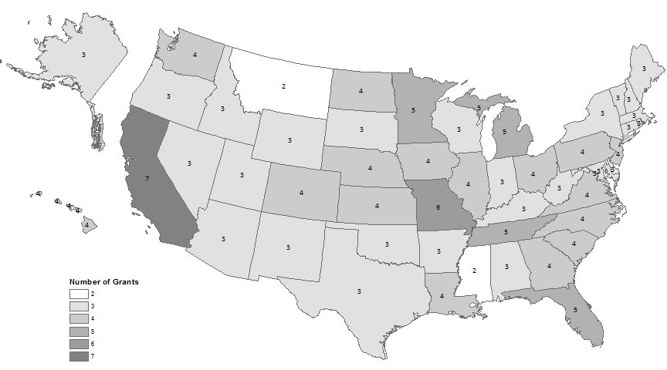
TAACCCT Grants Awarded Per State (Rounds 1-3)
Source: Urban Institute TAACCCT Grantee Database

Slide 14
TAACCCT Grant Funding (Rounds 1-3)
(In millions $) | Rounds 1-3 (%) | Round 1 (%) | Round 2 (%) | Round 3 (%)
Up to $2.5 | 17 | 4 | 34 | 4
Over $2.5 to $5 | 46 | 51 | 32 | 61
Over $5 to $10 | 2 | 2 | 1 | 4
Over $10 to $15 | 17 | 4 | 1 | 2
Over $15 to $20 | 21 | 17 | 0 | 4
Over $20.0 to $25 | 12 | 2 | 0 | 10
Total # of Grants: | 185 | 49 | 79 | 57
Source: Urban Institute TAACCCT Grantee Database

Slide 15
Top Ten Industries of Focus (Rounds 1-3)
Planned Industry | Rounds 1-3 (%) | Round 1 (%) | Round 2 (%) | Round 3 (%)
Manufacturing | 49 | 61 | 38 | 53
Professional, Scientific, and Technical Services | 39 | 51 | 33 | 39
Health Care and Social Assistance | 32 | 53 | 23 | 26
Transportation and Warehousing | 13 | 18 | 13 | 9
Utilities | 9 | 16 | 6 | 5
Construction | 9 | 16 | 5 | 7
Information | 8 | 4 | 9 | 9
Agriculture, Forestry, Fishing and Hunting | 7 | 10 | 4 | 9
Mining, Quarrying, and Oil and Gas Extraction | 6 | 10 | 3 | 7
Other Services (except Public Administration) | 5 | 8 | 3 | 5
Source: Urban Institute TAACCCT Grantee Database
Notes:
Add in %

Slide 16
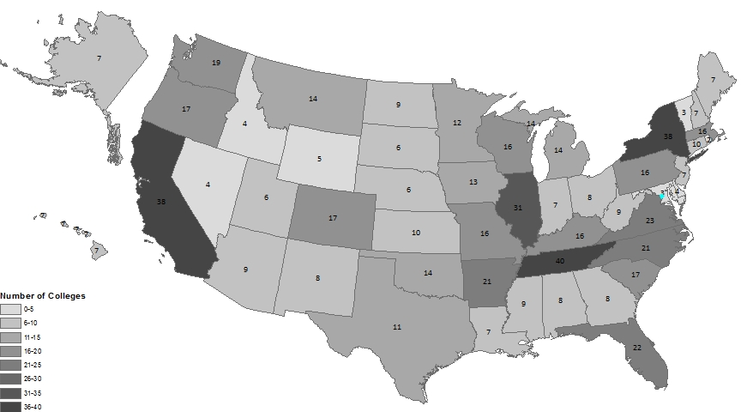
Geographic Distribution of Colleges Participating in TAACCCT Activities (Rounds 1-3) (n=645)
Source: Urban Institute TAACCCT Grantee Database
Notes:
N=645 unique institutions of higher education; According to the National Center on Education Statistics, there are 934 public 2-year institutions.

Slide 17
Top Ten Planned Program Components (Rounds 1-3)
 | Rounds 1-3 (%) | Round 1 (%) | Round 2 (%) | Round 3 (%)
Certificate Attainment | 70 | 53 | 77 | 74
Stackable Credentials | 66 | 37 | 82 | 68
Career Pathways | 64 | 55 | 67 | 67
Employer Partnerships | 63 | 57 | 67 | 63
Industry Recognized Credentials | 63 | 55 | 68 | 61
Technology Enabled Learning | 60 | 43 | 68 | 63
Retention/Retention Strategies | 57 | 71 | 56 | 46
Job Placement | 53 | 41 | 57 | 58
Industry Driven Competencies | 52 | 41 | 59 | 53
Degree Attainment | 45 | 35 | 56 | 40
Source: Urban Institute TAACCCT Grantee Database

Slide 18
Types of Planned Credentials (Rounds 1-3)
 | Rounds 1-3 (%) | Round 1 (%) | Round 2 (%) | Round 3 (%)
Professional license or certification | 81 | 92 | 77 | 75
Degree (AA or BA/BS) | 78 | 84 | 72 | 81
Certificate for course completion | 71 | 88 | 70 | 58
Other degree or certificate | 11 | 2 | 19 | 9
Credit for prior learning | 72 | 41 | 75 | 97
Source: Urban Institute TAACCCT Grantee Database

Slide 19
Average Number of Planned Partnerships per Grantee (Rounds 1-3)
 | Rounds 1-3 (#) | Round 1 (#) | Round 2 (#) | Round 3 (#)
Employer Partners | 10 | 8 | 9 | 12
Public Workforce Partners | 4 | 3 | 5 | 5
College/University Partners | 2 | 1 | 2 | 2
Other Key Partners | 3 | 3 | 3 | 3
Source: Urban Institute TAACCCT Grantee Database

Slide 20
Grantees Using Various Outcome/Impact Evaluation Methods (Rounds 1-3)
Method | Rounds 1-3 (#) | Round 1 (#) | Round 2 (#) | Round 3 (#)
Experimental Design | 6 | 0 | 6 | 0
Regression Discontinuity | 6 | 1 | 2 | 3
Propensity Score Matching | 53 | 1 | 16 | 36
Other Quasi-experimental /Non-Experimental | 56 | 0 | 43 | 13
Pre/Post-Analysis | 24 | 0 | 17 | 7
Outcome/Correlational | 10 | 0 | 5 | 5
Cost/Economic analysis | 10 | 0 | 2 | 8
Source: Urban Institute TAACCCT Grantee Database
Notes:
In Round 1, third-party evaluation was not required; a handful of the 48 grantees reported evaluation methods.
Round 2 grantees were required to submit 10-page summary evaluation plans, and their planned evaluation methods were culled from those 10-page summaries.
Round 3 grantees were required to select an independent third-party evaluator to conduct a rigorous evaluation of their program and to submit a detailed evaluation plan; and their planned evaluation methods were culled from those detailed evaluation plans.
ADD NOTE ON N/A and NO Difference

Slide 21
Next Steps for the National TAACCCT Evaluation

Slide 22
Next Steps for the National Evaluation
Collect detailed information on the approaches, training, and partnerships actually implemented across all Rounds 1-3 TAACCCT colleges through the survey
Study how TAACCCT activities were implemented and the successes and challenges of TAACCCT from multiple perspectives through the site visits to 20 Rounds 2-3 grants
Examine and synthesize the outcomes and impacts of the grant activities across all grants to build a body of evidence of workforce education and training approaches using the final third-party evaluation reports

Slide 23
Reminder!
Check out the TAACCCT evaluation website at:
www.taacccteval.org
For methods information, evaluation examples, peer-learning events, webinar recordings, and more….

Slide 24
Questions?
Lauren Eyster, Urban Institute
Project Director for the National TAACCCT Evaluation
leyster@urban.org
Partnering with:
Abt Associates, Capital Research Corporation, George Washington University, Jobs for the Future, and NORC at the University of Chicago

