Slide 1
Transformative Change Initiative (TCI) Evaluation Collaborative Meeting: November 10, 2015.
Using Mixed Methods Evaluation Evidence to Scale TAACCCT-tested Innovations in Missouri Community Colleges
John J. Cosgrove, Cosgrove & Associates, LLC
Margaret S. Cosgrove, Cosgrove & Associates, LLC
Debra D. Bragg, Bragg & Associates, Inc.

Slide 2
MoHealthWINs: A Focus On The Adult, Economically and Academically Disadvantaged Target Group
Access To College
Academic Success & Program Completion
Improve Employment Outlook and Economic Future
Innovative Programs & Services

Slide 3
MoHealthWINs Colleges Were Up to the Challenge
Recruited and provided college access for the target population.
Using employer input developed short-term, accelerated programs to meet the needs of economically and academically disadvantaged adults.
Provided extensive academic and personal support systems.

Slide 4
Access for Target Population
Did the grant increase access to higher education for the target populations?

Slide 5
Access To College For Target Population
4,251 Total Grant Participants
82% Either Under Employed or Unemployed At Initial Enrollment
Average Age = 35
42% No Previous College Enrollment
78% Academically Under-Prepared
At Initial Enrollment

Slide 6
Program Completion
Did participants complete program of study, credentials & credit hours?

Slide 7
Program and Credit Hour Completion
66% Completed A Grant Funded Program of Study
Credit Hour Completion to Attempted Ratio = 84%

Slide 8
Employment
Did Program completers secure employment?

Slide 9
Program Completer Employment & Wages
80% of All Program Completers Were Employed Upon Program Completion
75% of Program Completers Who Began As Unemployed Were Employed Upon Program Completion
Average Annual Wage For Program Completers Who Started As Unemployed and Secured Employment Upon Program Completion = $23,050

Slide 10
The MHW Grand Experiment: What Did The Colleges Do? What Did The Colleges Learn? What Holds Promise For Scaling?
The
Experiment
CTE Program Development Using Career Pathways Built Upon Industry-Recognized Stackable Credentials
Intentional & Proactive Instructional Student Support Intervention Strategies
Design of Development Education Strategies & Instructional Modalities

Slide 11
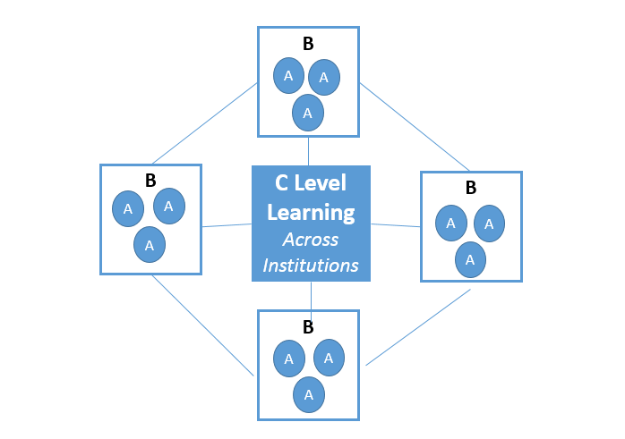
Scaling Through The Use of Networked Improvement Communities
Asset Mapping to Reveal:
Learning at the Local Level (Level A)
Expand Learning Within Institutions (Level B)
Scaling Across Institutions (Level C)
Schema for social learning (adapted from Bryk, Gomez, Grunow, and LeMahieu, Learning to Improve

Slide 12
Questions, Comments, Suggestions

